Slide 1
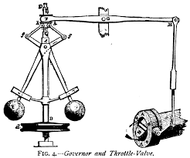
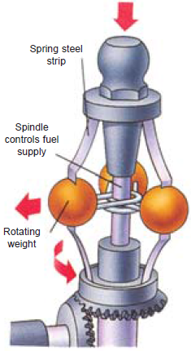
Theory of machines Wessam Al Azzawi
Governors:
The function of a governor is to regulate the speed of an engine when there are variations in the load.
When the load increases, its speed decreases, and becomes necessary to increase the supply of fuel. On the other hand, when the load decreases, its speed increases and thus less fuel is required.
The governor automatically controls the supply of fuel to the engine to keep the speed within certain limits.
Centrifugal Governors:
A governor controls engine speed. As it rotates, the weights swing outwards, pulling down a spindle that reduces the fuel supply at high speed.
Governor

Slide 2
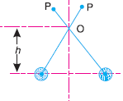
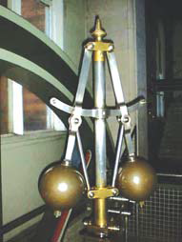
Theory of machines Wessam Al Azzawi
Governors:
Terms Used in Governors:
Height of a governor.
It is the vertical distance from the centre of the ball to a point where the axes of the arms intersect on the spindle axis. It is usually denoted by h.
2. Equilibrium speed.
It is the speed at which the governor balls are in complete equilibrium and the sleeve does not tend to move upwards or downwards.
3. Mean equilibrium speed.
It is the speed at the mean position of the balls or the sleeve.
4. Maximum and minimum equilibrium speeds.
The speeds at the maximum and minimum radius of rotation of the balls, without tending to move either way are known as maximum and minimum equilibrium speeds respectively.
5. Sleeve lift. It is the vertical distance which the sleeve travels due to change in equilibrium speed.

Slide 3
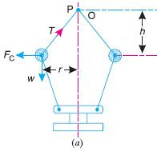
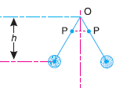
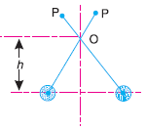
Theory of machines Wessam Al Azzawi
Governors:
Watt Governor:
It is the simplest form of a centrifugal governor, as shown in Fig.
It is basically a conical pendulum with links attached to a sleeve of negligible mass. The arms of the governor may be connected to the spindle in the following three ways :
1. The pivot P, may be on the spindle axis as shown in Fig. (a).
2. The pivot P, may be offset from the spindle axis and the arms when produced intersect at
O, as shown in Fig. (b).
3. The pivot P, may be offset, but the arms cross the axis at O, as shown in Fig.(c).

Slide 4
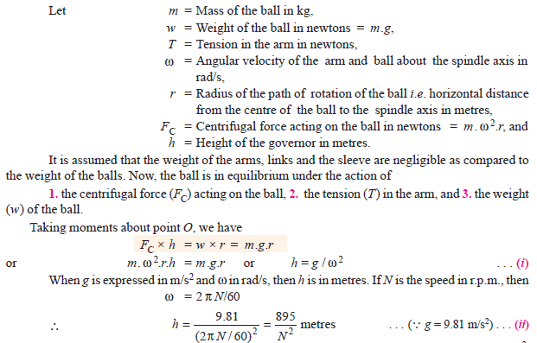
Theory of machines Wessam Al Azzawi
Governors:
Watt Governor:

Slide 5
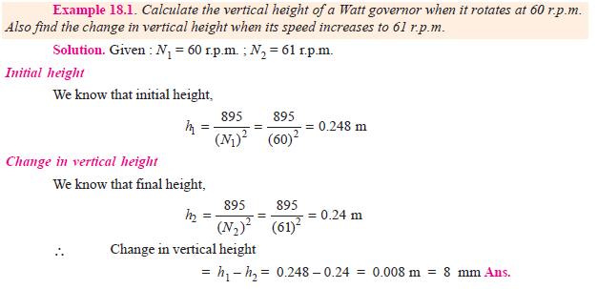
Theory of machines Wessam Al Azzawi
Governors:
Watt Governor:

Slide 6
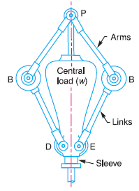
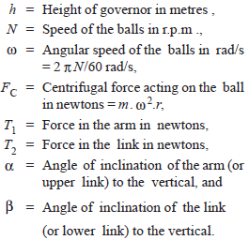
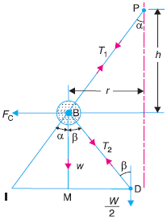
Theory of machines Wessam Al Azzawi
Governors:
Porter Governor:
The Porter governor is a modification of a Watt’s governor, with central load attached to the sleeve as shown in Fig.

Slide 7
Theory of machines Wessam Al Azzawi
Governors:
Porter Governor:

Slide 8
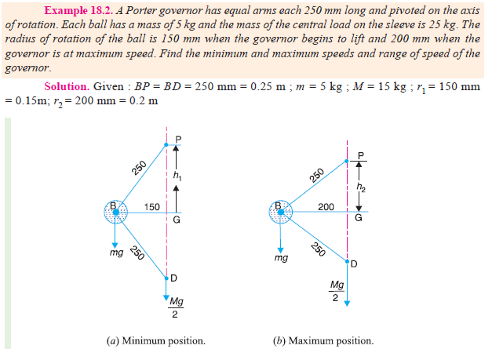
Theory of machines Wessam Al Azzawi
Governors:
Porter Governor:

Slide 9
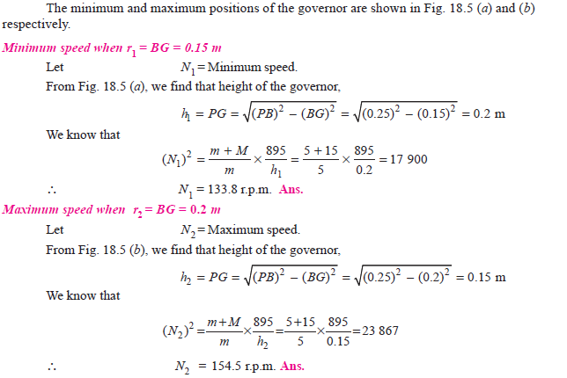
Theory of machines Wessam Al Azzawi
Governors:
Porter Governor:

Slide 10
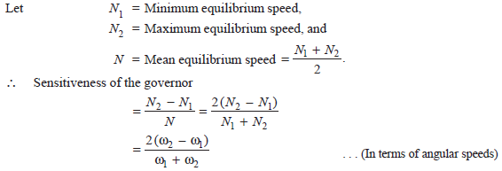
Theory of machines Wessam Al Azzawi
Governors:
Sensitiveness of Governors:
Consider two governors A and B running at the same speed. When this speed increases or decreases by a certain amount, the lift of the sleeve of governor A is greater than the lift of the sleeve of governor B. It is then said that the governor A is more sensitive than the governor B.
Sensitiveness is defined as the ratio of the difference between the maximum and
minimum equilibrium speeds to the mean equilibrium speed

Slide 11
Theory of machines Wessam Al Azzawi
Governors:
Effort and Power of a Porter Governor:
The effort of a governor is the mean force exerted at the sleeve for a given percentage change of speed (or lift of the sleeve). It may be noted that when the governor is running steadily, there is no force at the sleeve. But, when the speed changes, there is a resistance at the sleeve which opposes its motion. It is assumed that this resistance which is equal to the effort, varies uniformly from a maximum value to zero while the governor moves into its new position of equilibrium.
The power of a governor is the work done at the sleeve for a given percentage change of speed. It is the product of the mean value of the effort and the distance through which the sleeve moves. Mathematically,
Power = Mean effort × lift of sleeve

Slide 12
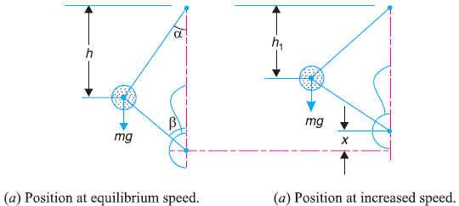
Theory of machines Wessam Al Azzawi
Governors:
The effort and power of a Porter governor may be determined as discussed below:
Let N = Equilibrium speed corresponding to the configuration as shown in Fig.(a)
c = Percentage increase in speed.
∴ Increase in speed = c.N
and increased speed = N + c.N = N (1 + c)
The equilibrium position of the governor at the increased speed is shown in Fig.(b).
when the speed is N r.p.m., the sleeve load is M.g. Assuming that the angles α and β are equal, so that q =$\frac{tanβ}{tanα}$= 1, then the height of the governor,

Slide 13
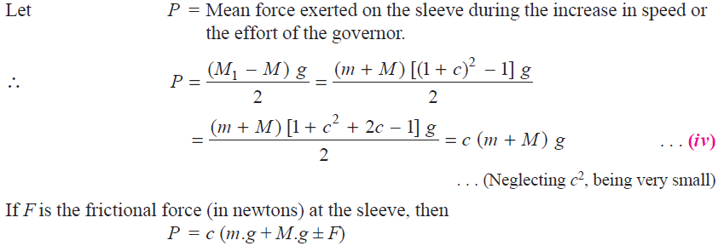
Theory of machines Wessam Al Azzawi
Governors:
If the speed increases to (1 + c) N r.p.m. and the height of the governor remains the same, the load on the sleeve increases to M1.g. Therefore
Equating equations (i) and (ii), we have:

Slide 14
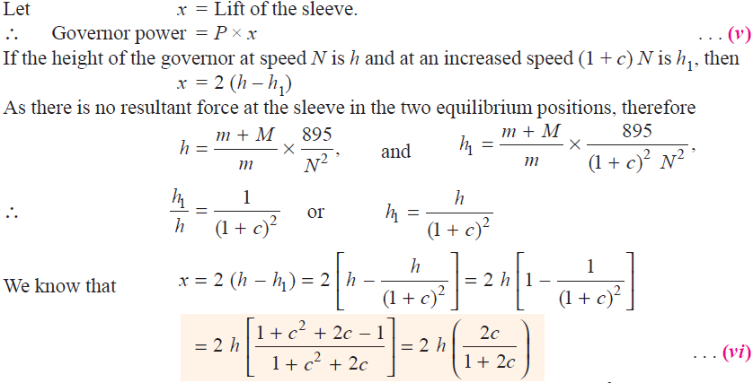
Theory of machines Wessam Al Azzawi
Governors:

Slide 15
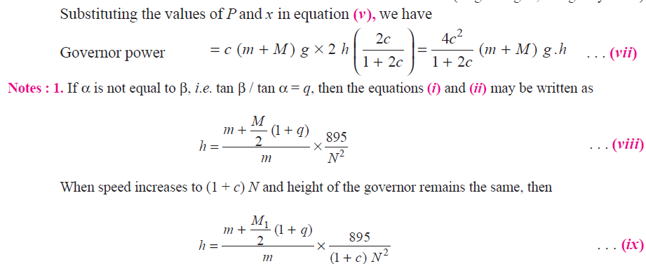
Theory of machines Wessam Al Azzawi
Governors:

Slide 16
Theory of machines Wessam Al Azzawi
Governors:

Slide 17
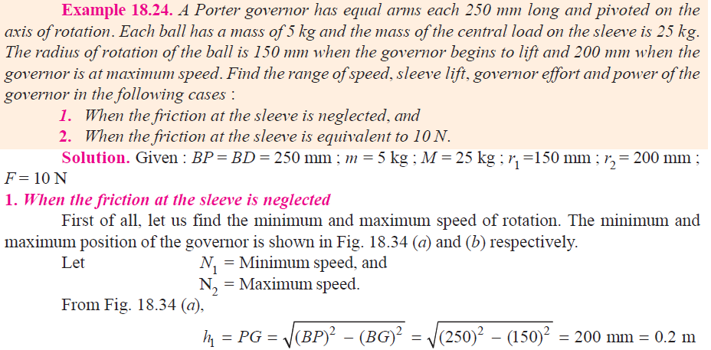
Theory of machines Wessam Al Azzawi
Governors:

Slide 18
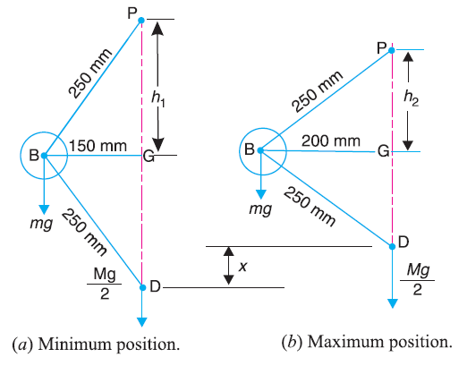
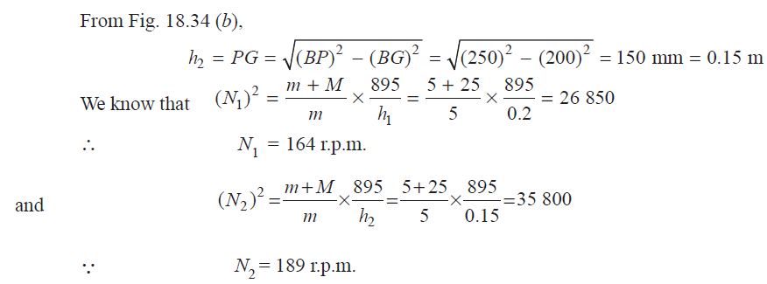
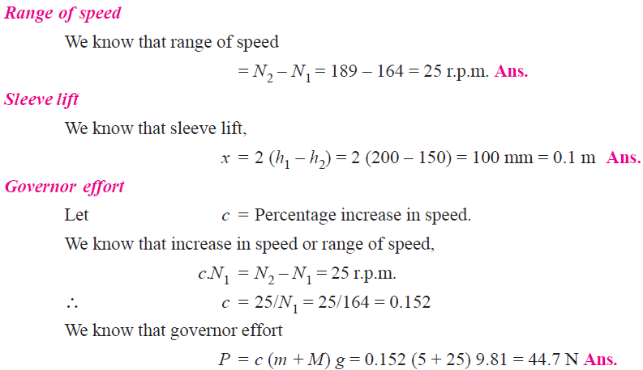
Theory of machines Wessam Al Azzawi
Governors:

Slide 19
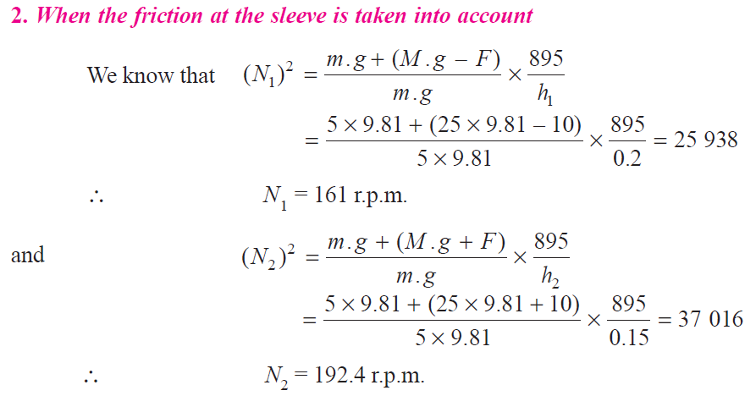
Theory of machines Wessam Al Azzawi
Governors:

Slide 20
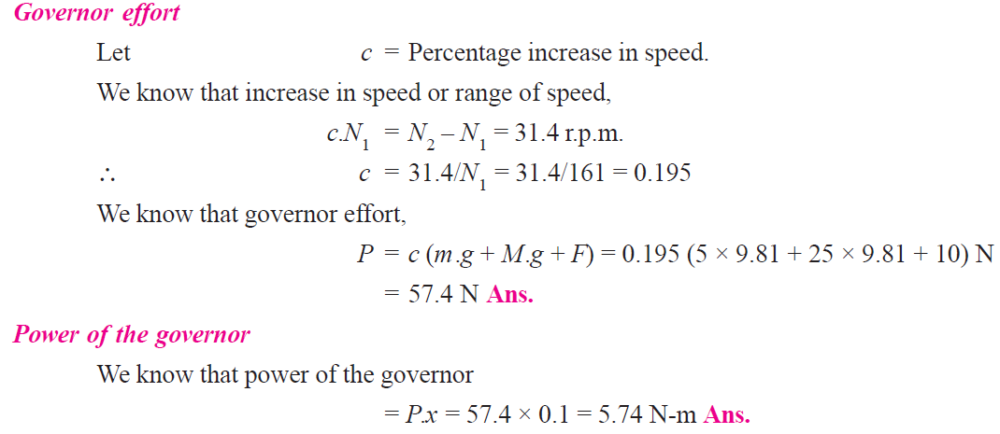
Theory of machines Wessam Al Azzawi
Governors:

